Slide 1



Care After Crisis:
Alternatives After ed Discharge
Sponsored & Facilitated by
Hospital System Addictions Care Community of Practice
Thursday, August 15, 2024

Slide 2
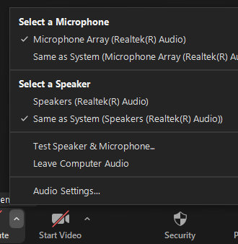
Housekeeping
Notes:
We are recording today’s meeting, so we ask that everyone mute your microphone when not speaking.
If you are having internet issues, try turning off your video camera or join by phone.
If you are having trouble hearing, expand the audio icon to open the Audio Settings – here you can select a different speaker from the menu or adjust the volume.

Slide 3
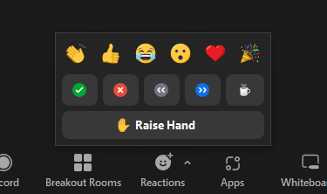
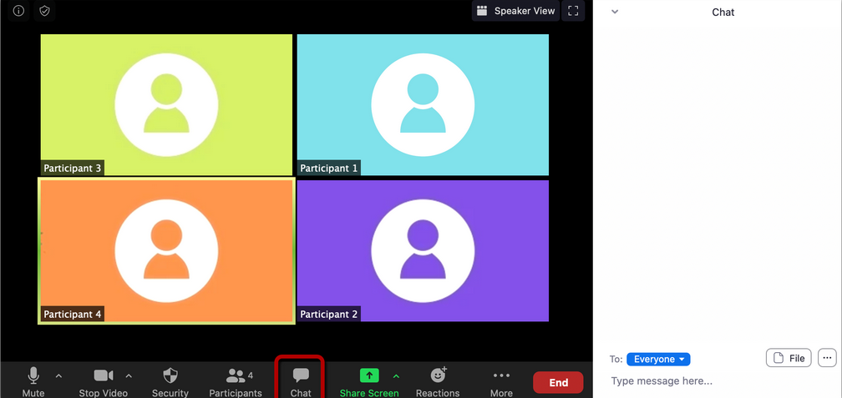
Zoom Engagement Tools
Notes:
We also encourage you to use the emoticons under your reactions tool bar to help convey emotions virtually – this could be in response to something you hear from the presenters.
Please note we will be using the chat feature for participants to post general questions to presenters. Please refrain from posting personal questions. A moderator will be posing the questions to presenters at the end of both presentations.

Slide 4
Meeting Objectives
Learn how to make the appropriate connections for ongoing care
Learn some of the tools to help the individual engage treatment after discharge from the Ed
Engage with the people and organizations providing this service

Slide 5
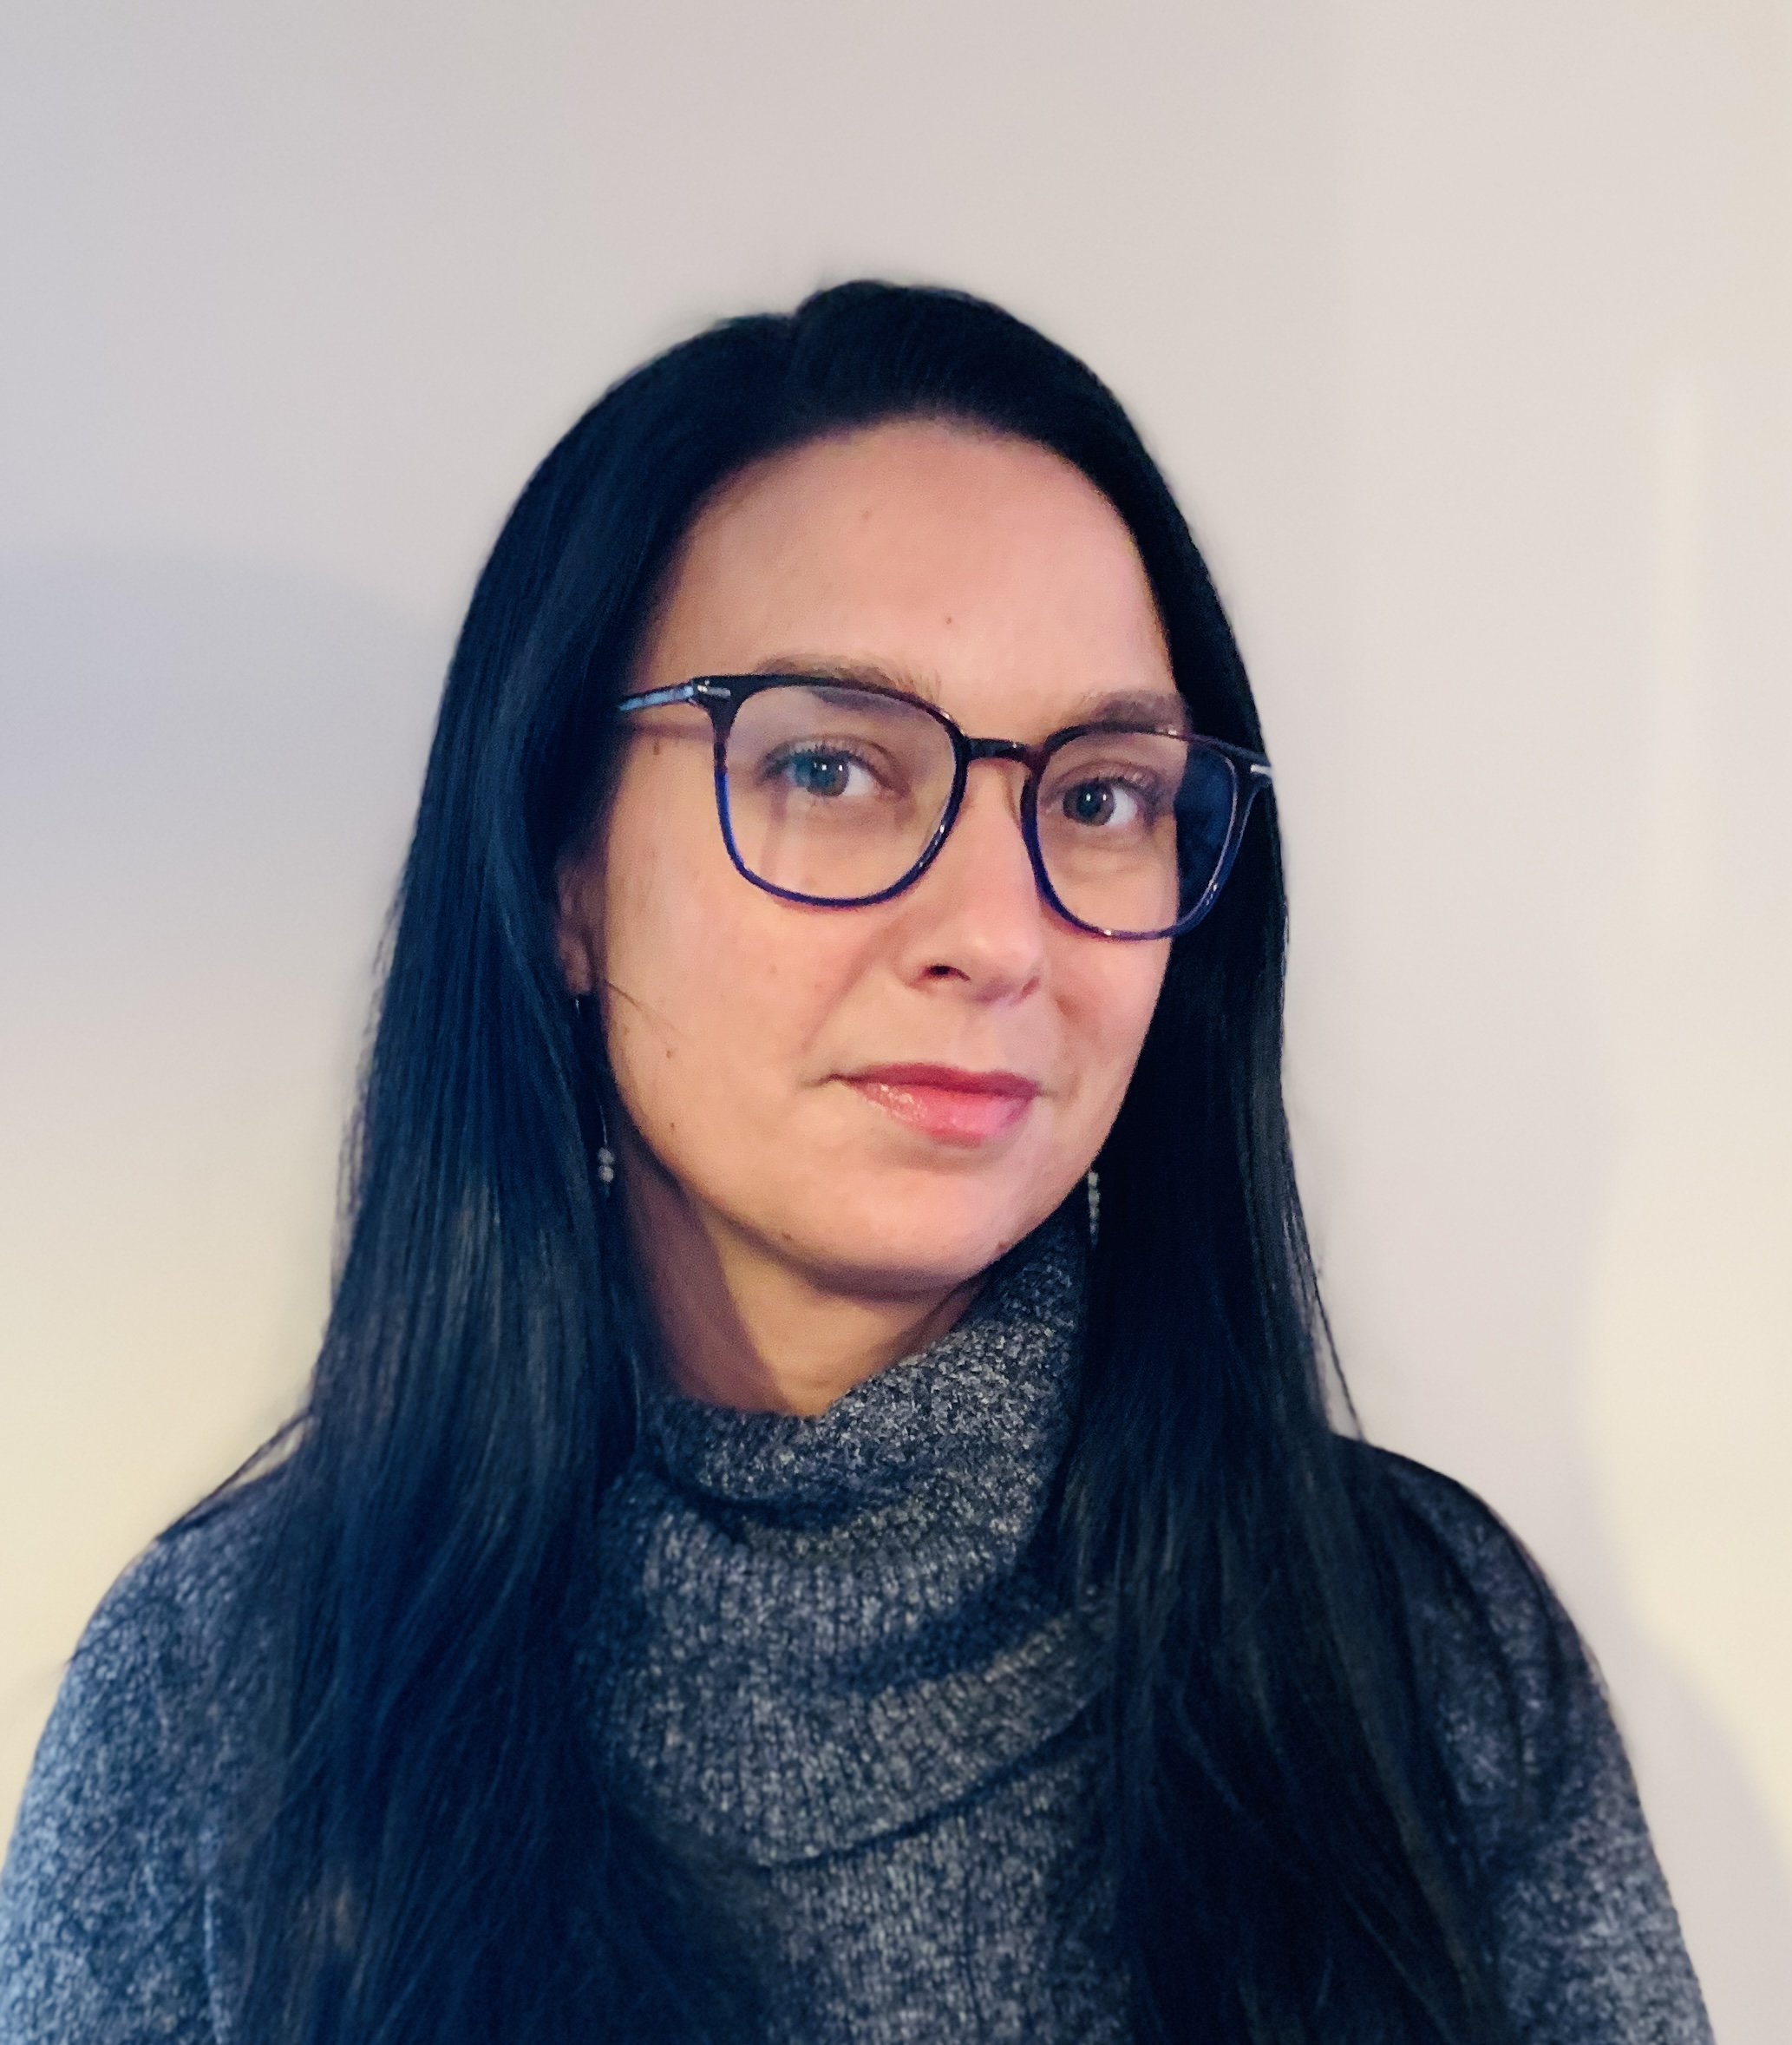

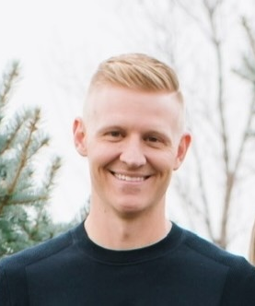
Today’s Presenters
Jill Fitzgerald, M.S.W., LICSW
Senior Vice President of Clinical Operations, Confidant Health
Jon Peters, D.O.
Medical Director, Better Life Partners
Zach Jenson
Co-founder, Aspire365

Slide 6
The future of behavioral health, today.
Hospital Partnerships—2024

Slide 7
1 in 3
We have a mental health & substance use crisis in America.
Adults 18+ had a mental illness or substance use disorder in the past year
Substance Use Disorder Mental Health Condition Co-Occurring MH + SUD

Slide 8



Most DO NOT get care
Deadly consequences
Despite billions spent, the problem continues to get worse.
75% of SUD and 50% of mental health patients
Stigma
On average, people wait 10 years
from symptom onset to starting care.
Poor Options
90% don’t believe the existing treatment options will help them.
107,622
Deaths by drug overdose
48,183
Deaths by suicide

Slide 9


For high-cost claimants
Addressing behavioral health is critical to reducing claims.
Adults with BH conditions incur 3–6x higher medical costs.
66%
Have a diagnosable behavioral health condition
$7,000
Additional spending on medical and surgical costs per year
50%
Had less than $95 per year total spending on BH treatments

Slide 10
We are here to help you ensure exceptional behavioral health services are available to your patients.

Slide 11







Confidant Health is a Distributed Quality Network
AI-powered platform & integrated provider network delivering great behavioral health outcomes for partners.
Appointment booked!
Available on mobile, desktop, & in person:

Slide 12



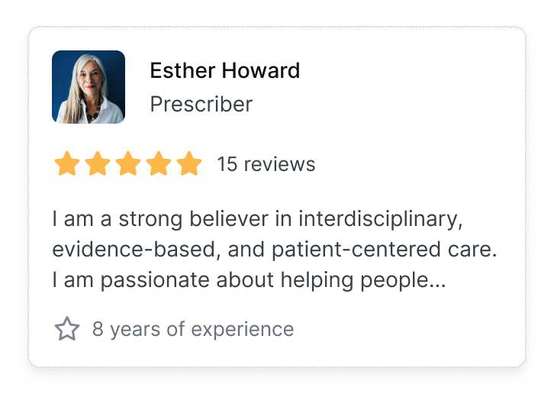
How we help you
You’ve been matched!
Confidant Health helps partners by efficiently & effectively managing behavioral health patients.
Your team gets a simple solution for patient referrals and you get:
Improved accountability
Transparent outcomes
Lower clinical costs

Slide 13
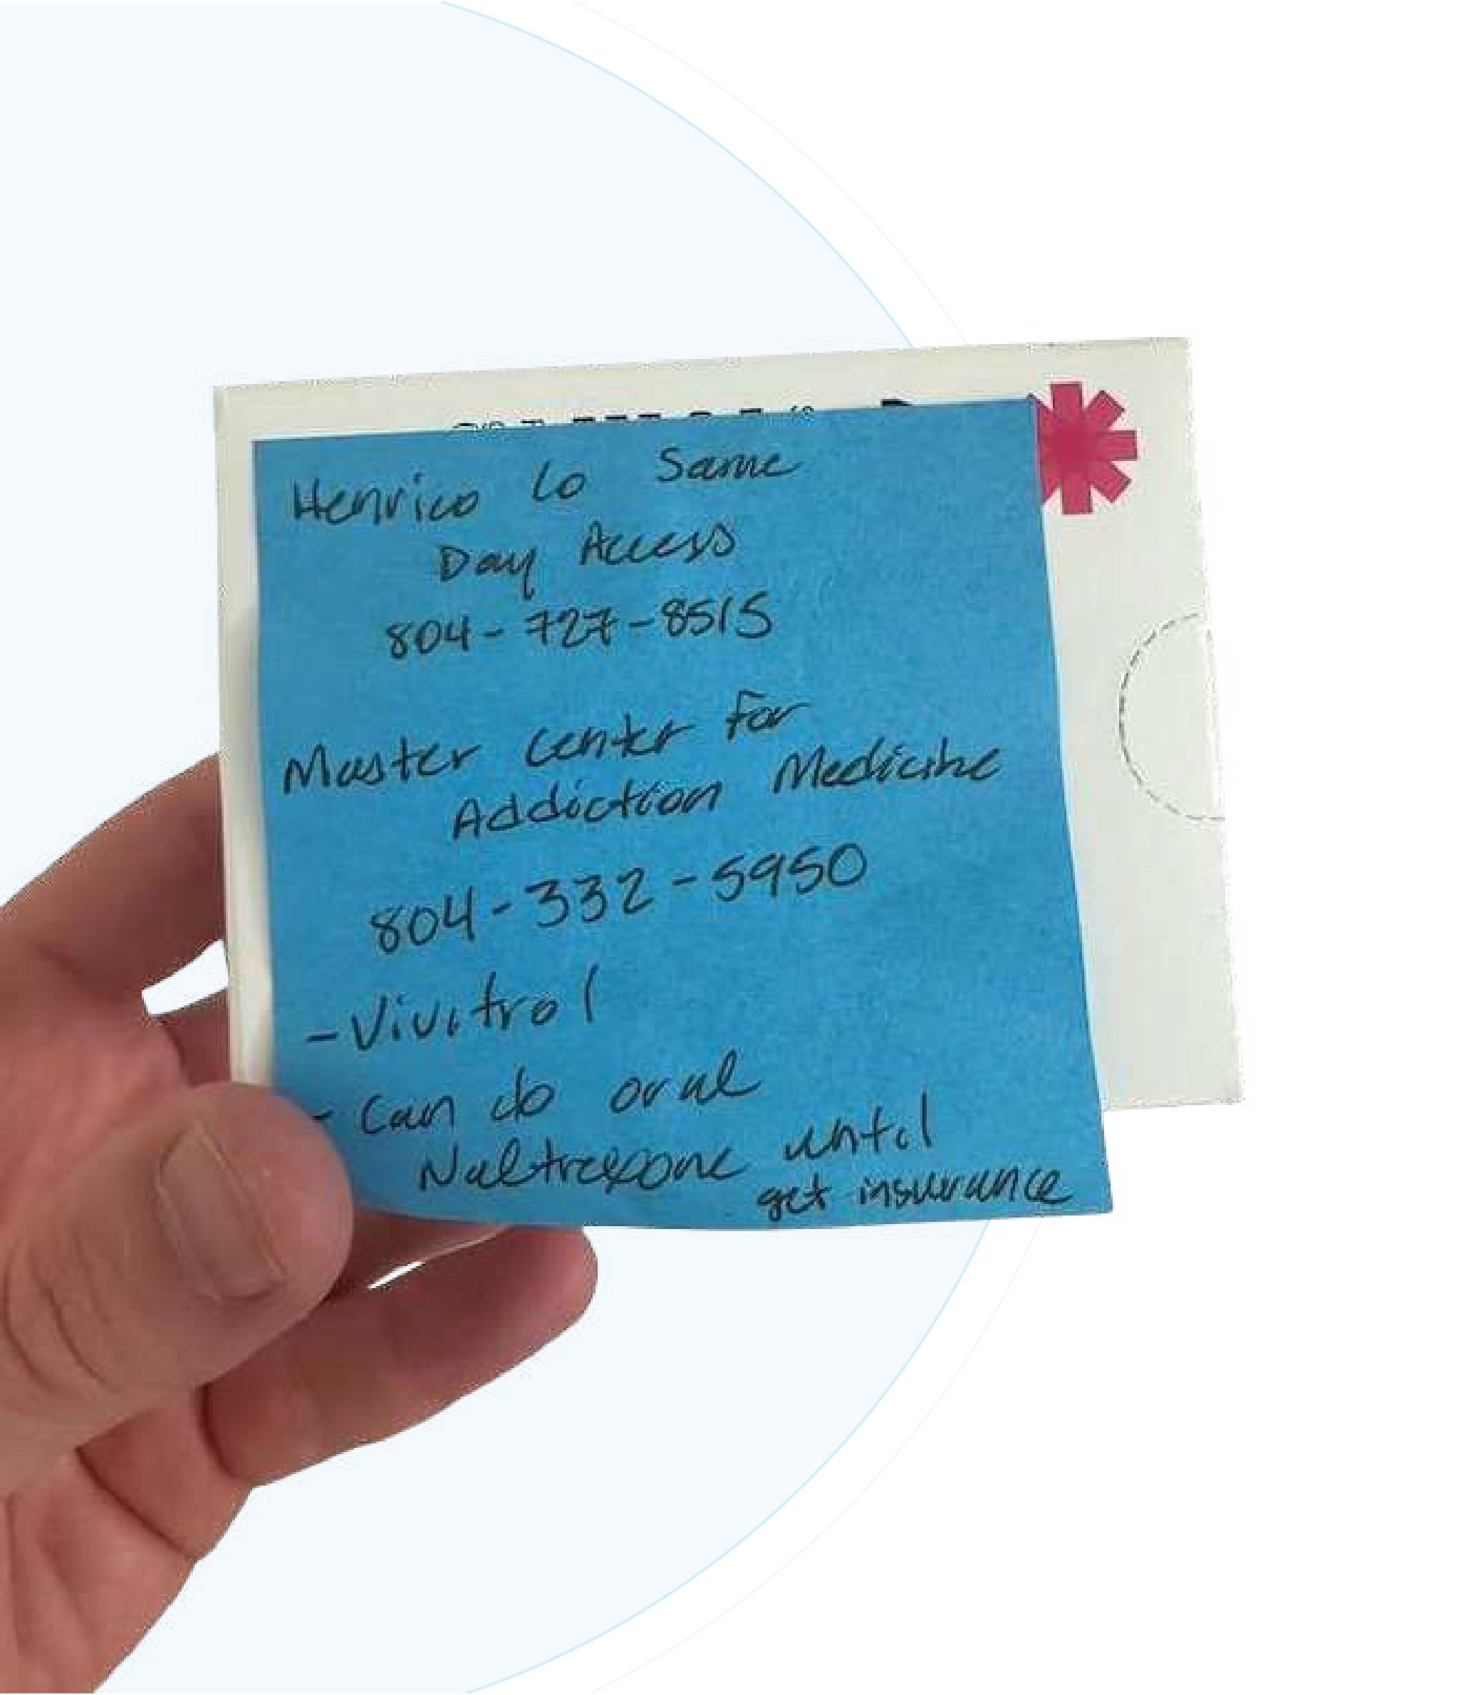

How we help patients
Confidant Health provides patients with the seamless, intuitive experience they expect from leading brands.
Make paper referrals a thing of the past!
The process for patients:
Get connected through proactive outreach
Get matched with the right provider(s)
Get better behavioral health outcomes

Slide 14







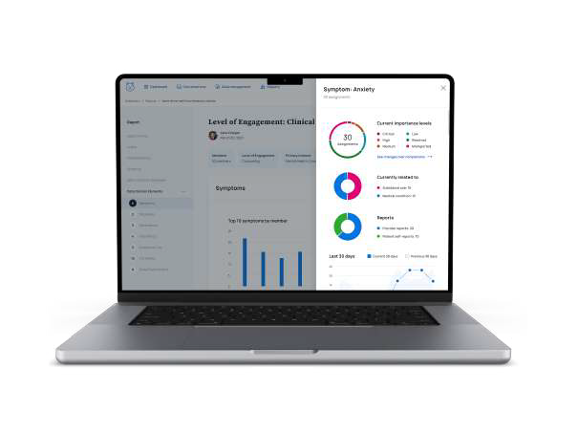
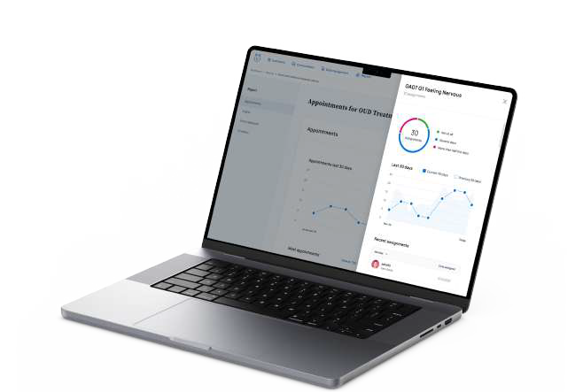
Our care team
We accept most major insurance plans:
Our care team model efficiently & effectively manages large BH patient populations with:
& many more
Care Managers
Nurse Practitioners
Physicians
Therapists
Coaches

Slide 15
Services We Provide
Psychiatric Evaluations
Psychiatric Med Management
Medication for Addiction Treatment
Evidenced-based therapy
Care Navigation
Groups
Coaching
We are a full-service behavioral health clinic that provides measurement based psychiatric interventions & medication management, including prescribing of controlled substances.
In-network with your insurances
No wait lists for patients
Care navigation included if we’re not a fit

Slide 16

Who we serve
A diverse population across
rural and urban settings:
Range in age from 18 to 74
46% insured by Medicaid
55% have trouble making ends meet
17% with food insecurity
17% have issues with transportation
Family groups available

Slide 17





How it works
We designed the fully integrated data architecture of the Confidant Platform to be optimized for next-gen machine learning & AI at scale.
Recommendations for chat
outreach & responses
Validate data collected
in provider evaluations
The Confidant Platform helps providers deliver effective interventions based on symptoms & diagnosis & to track outcomes.
Identify relevant clinical data
not captured in documentation
Build highly personalized
treatment plans

Slide 18









Flexible Referral Pathway
EMERGENCY ROOM PROVIDER
Confidant Health seamlessly integrates into the current referral system at any practice.
By supporting multiple referral paths, the implementation is simplified, allowing the clinical team to continue practicing as usual.
APP
FAX
DIRECT
WEEKLY, MONTHLY, OR QUARTERLY POPULATION HEALTH MANAGEMENT MEETINGS (OPTIONAL)
CONFIDANT CARE TEAM

Slide 19
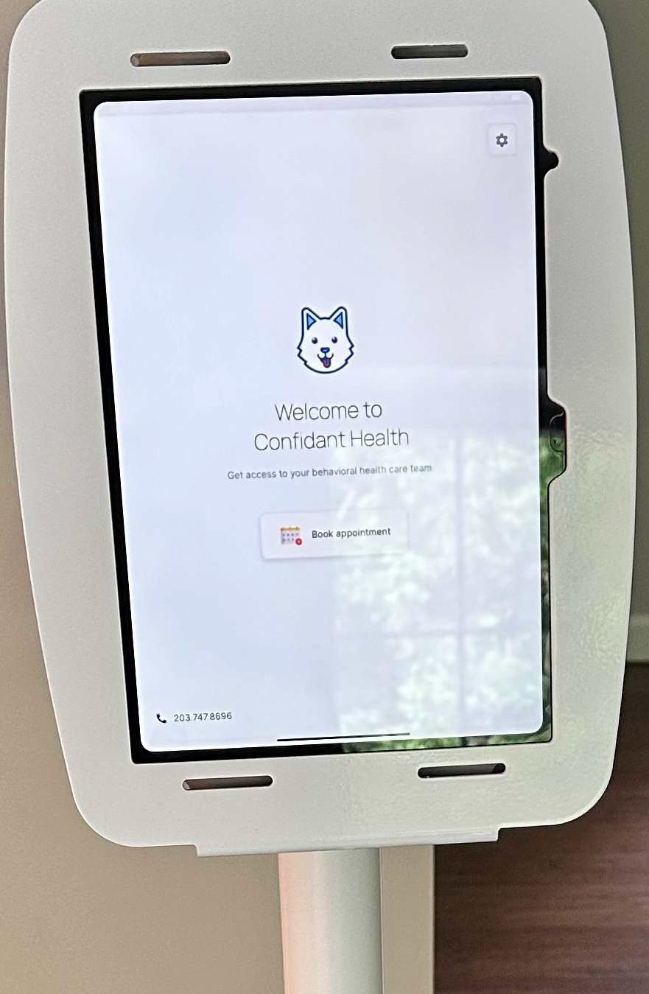
Referrals Made Even Easier
The Confidant Kiosk for EDs
Currently launching in a NH ED to make referrals seamless for ED providers
ED providers can support patients booking their Confidant appointment before leaving the ED
Bridge access to timely follow up care for treatment initiated in the ED

Slide 20




Partnership Benefits:
Psychiatric evaluations
to support medical care
Measurable increase
in patient satisfaction
By partnering with Confidant Health, each health system unlocks a new range of clinical experiences & best practices for their patients.
Increased screening with evidence-based tools
Warm handoffs
not external referrals

Slide 21
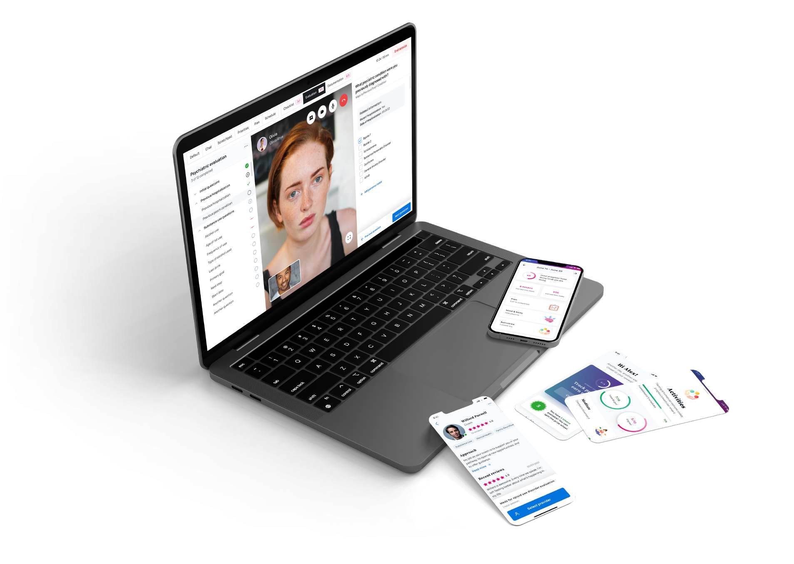
Outcomes Opportunity:
The Confidant Platform demonstrates qualitatively & quantitatively the impact of treatment on an individual & system level.
PHQ-9 GAD-7 SOWS
Healthy Days SDoH
BAM-R WHOQOL-BREF WHO-HPQ
+ many more options
We work with partners to define:
Key Outcomes Managed
Inclusion/Exclusion Criteria
Reporting Cadence

Slide 22
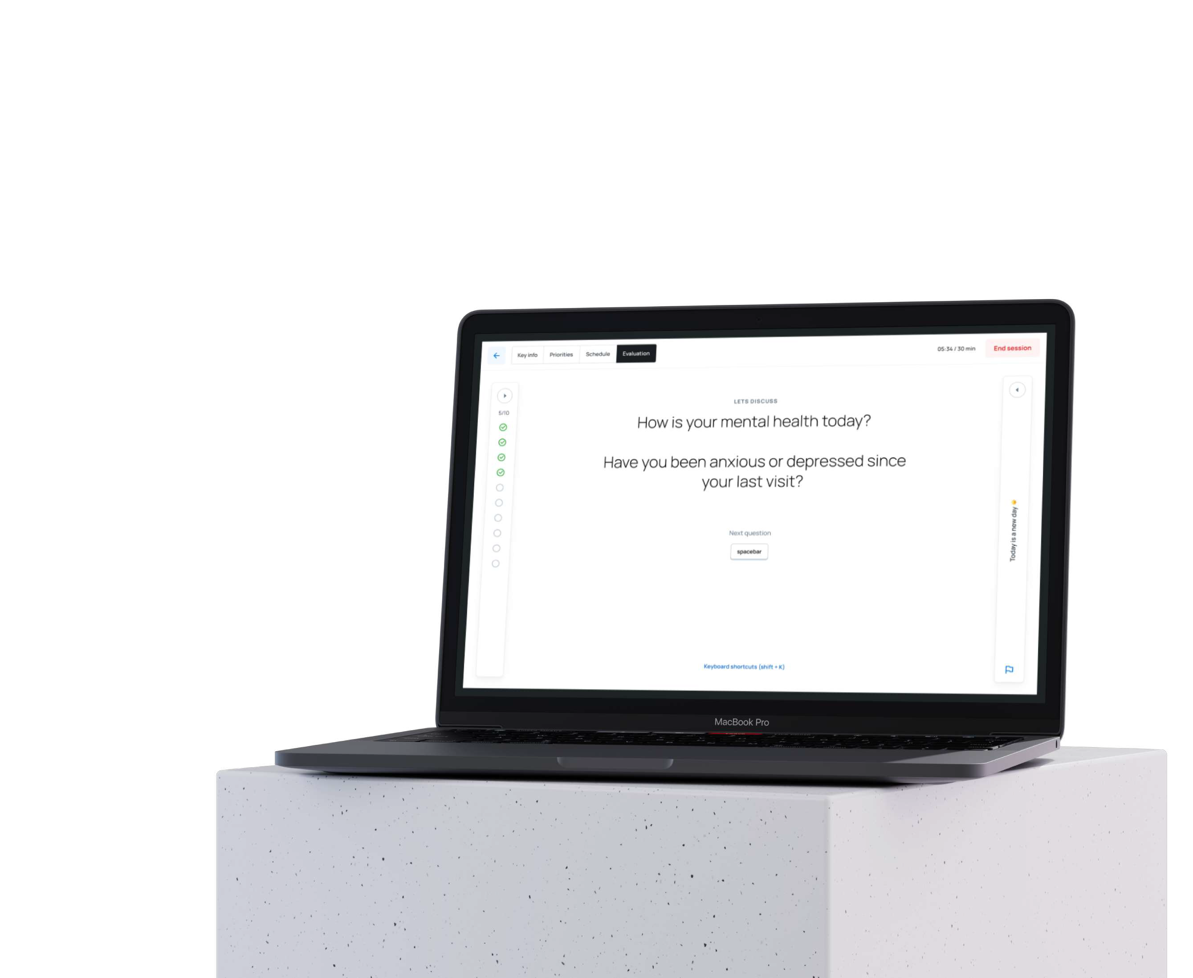

Outcomes to date:
Outcomes Collected
Referral Generated
In one partnership with a Medicaid MCO, Confidant Health has delivered the following outcomes for a clinically complex population:
84% member engagement rate
88% of members with reduction in PHQ9
94% of members with reduction in GAD7
100% FUH within 7 days
80% engagement for MAT

Slide 23
“
”
We were determined to find a way to increase access to Behavioral and SUD services in our state. Confidant has a local understanding of the market, provides high quality services by licensed providers, 24/7 access and timely follow up for appointments. The program is comprehensive and works with the patient where they are at in their healing process to develop and deliver a winning outcome. The leadership is committed to their program and to the population that they serve. They are well trained , experienced, and versed in the care that they deliver. I have worked in this business for
35 years and am very pleased and impressed with the
The Confidant Difference
Confidant partners with some of the largest national health plans & most respected health systems, developing unique protocols for each partner including:
VBC Data Collection Requirements
Contracts (FFS + Risk Based)
Patient Population + Clinical Needs
“
”
level of service provided by Confidant.
Primary Partner Chief Medical Officer

Slide 24


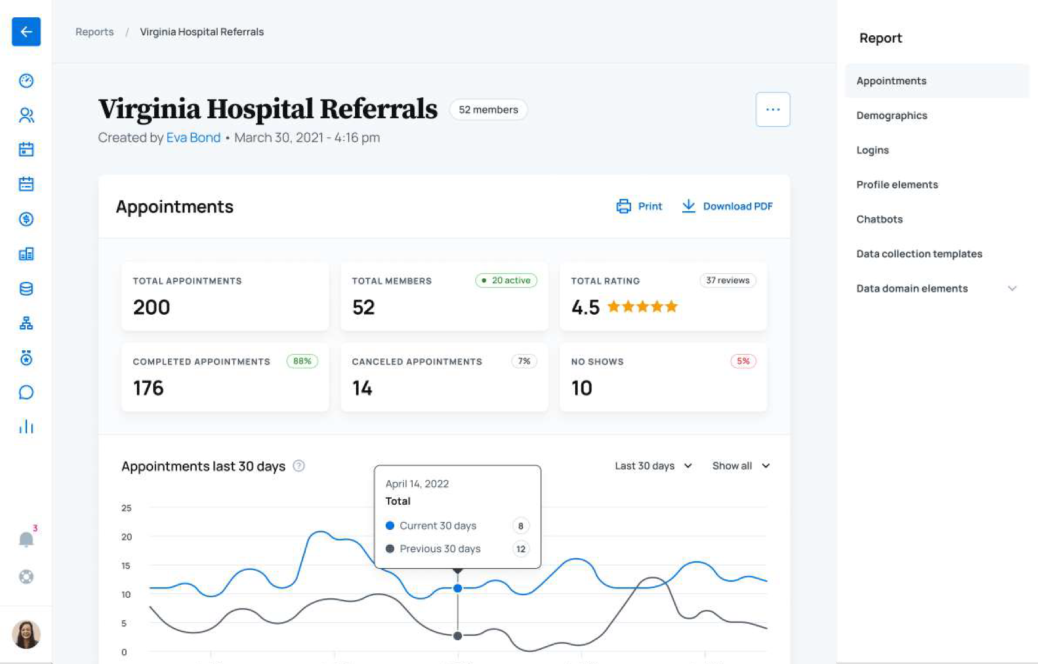
Partner now to transform your patients’ behavioral health outcomes.
Reach out to partners@confidanthealth.com
Thank you!

Slide 25

Confidential

Slide 26



The Next 10 Minutes in a Nutshell:
The Next 10 Minutes:
Introductions
The Warm Handoff
The Rapid Micro- Induction
How to Connect
{Spoiler Alert}

Slide 27
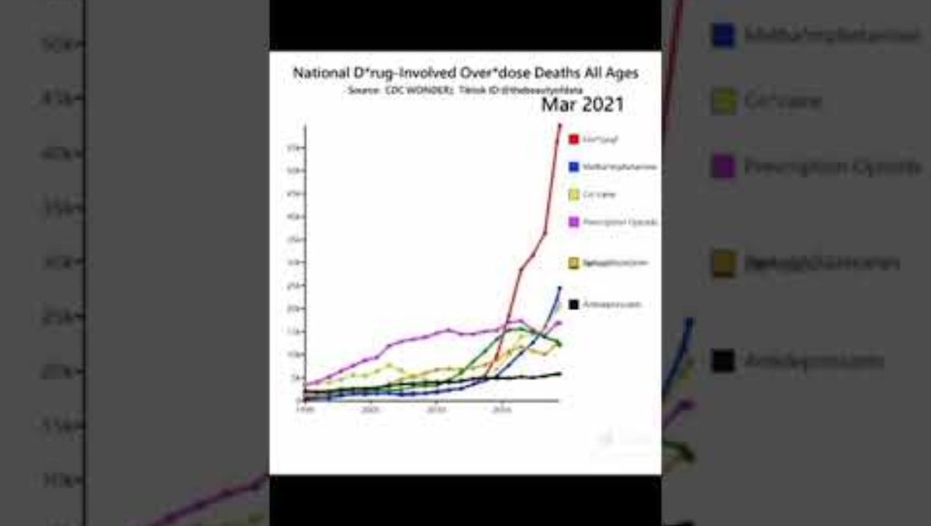
Before We Start…

Slide 28
Jon Peters, D.O.
Medical Director - BLPNH
jonathan.peters@betterlifepartners.com
BLP Central: (866)679-0831
(me)

Slide 29

Disclosures:
Jon’s Disclosures:
Medical Director for Better Life Partners, NH
Director of Weaken the Impossible (harm reduction medical education)
The Next 10 Minutes:
Introductions
The Warm Handoff
The Rapid Micro- Induction
How to Connect
Weaken the Impossible

Slide 30
Better Life Partners:
It is our mission to provide whatever it takes to help people heal from addiction
- whenever, wherever -
and find belonging, love and purpose.
We believe in the power of community and interpersonal relationships, which are strengthened when we meet our members.
The Next 10 Minutes:
Introductions
The Warm Handoff
The Rapid Micro- Induction
How to Connect

Slide 31

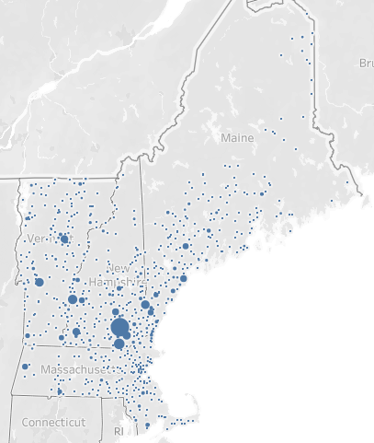
Confidential
The People We Serve:

Slide 32
What We Do:
Teams-Based Hybrid Care for People With Substance Use Disorders
  Opioid Use Disorder
  Alcohol Use Disorder
  Polysubstance Use Disorders
Recovery Coaching
Group Counseling
Responsive Care and Virtual Responsive Care (VRC)
Psychiatric Care
In-person care
  M-F 9-5 at our Manchester Clinic at 456 Union Street
  Weekly to Monthly at our 8 Partner Sites Around the State
The Next 10 Minutes:
Introductions
The Warm Handoff
The Rapid Micro- Induction
How to Connect

Slide 33
What We Do:
But, what we really offer is access:
  Same-day access to care (usually same phone call)
  Anyone struggling with OUD or AUD is Accepted:
    All Adults
    All Locations
    All Payers (or none at all)
The Next 10 Minutes:
Introductions
The Warm Handoff
The Rapid Micro- Induction
How to Connect

Slide 34

The Warm Handoff
This sucks.
The Next 10 Minutes:
Introductions
The Warm Handoff
The Rapid Micro- Induction
How to Connect

Slide 35
The Warm Handoff
Our goal is to never miss a handoff.
Call Us Anytime For Intakes.
  M-F 8a-8p – Same-Day Appts
  Saturday 10a-4p
  Nights and Weekends: We’ll get folx in the next business day.
  Need a curbside?
    Just call (or text): 866.679.0831
The Next 10 Minutes:
Introductions
The Warm Handoff
The Rapid Micro- Induction
How to Connect

Slide 36

Buprenorphine Inductions
The Next 10 Minutes:
Introductions
The Warm Handoff
The Rapid Micro- Induction
How to Connect

Slide 37

Buprenorphine Inductions
There are lots of ways to do a good induction.
You don’t need to wait for severe withdrawal to start.
The Next 10 Minutes:
Introductions
The Warm Handoff
The Rapid Micro- Induction
How to Connect

Slide 38
The Rapid Microinduction
Wait 8-12 hours from last use (use comfort meds PRN)
Then start with LOW-dose bupe to start slowly displacing fentanyl at the opioid receptors.
After 5 hours, give the remainder of the total daily dose (24 mg)
Still in withdrawal after 1 hour? Give an additional 8 mg.
The Next 10 Minutes:
Introductions
The Warm Handoff
The Rapid Micro- Induction
How to Connect

Slide 39
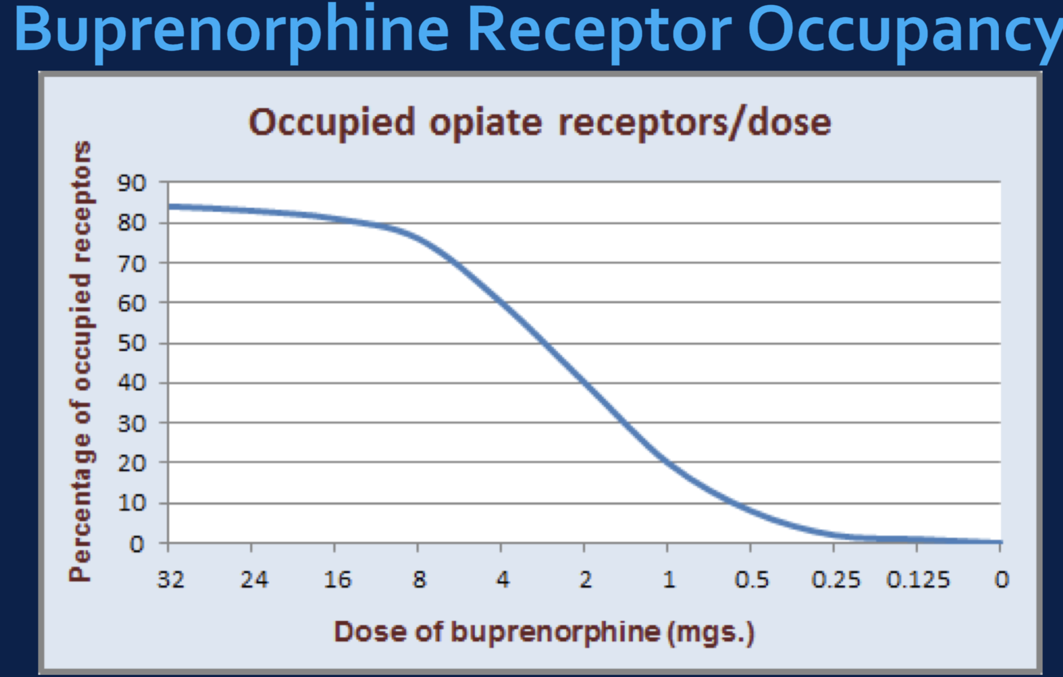
The Rapid Microinduction
The Next 10 Minutes:
Introductions
The Warm Handoff
The Rapid Micro- Induction
How to Connect

Slide 40
The Rapid Microinduction
Day 1: (8-12 hrs from last use)
    Hour 0 - Take 0.5 mg
    Hour 1 - Take 0.5 mg
    Hours 2-4 - Take 1 mg/hr x 3 doses
    Hour 5 - Take 16 mg
    Hour 6 - If still in w/d take an additional 8 mg
Day 2:
    Take full dose as prescribed
The Next 10 Minutes:
Introductions
The Warm Handoff
The Rapid Micro- Induction
How to Connect

Slide 41
The Rapid Microinduction
If at any point in the first 5 hours the patient experiences severe precipitated withdrawal, proceed to the step where you give the entire 16 mg.
The Next 10 Minutes:
Introductions
The Warm Handoff
The Rapid Micro- Induction
How to Connect

Slide 42

How to Connect
Just call. We’ll do the rest.
The Next 10 Minutes:
Introductions
The Warm Handoff
The Rapid Micro- Induction
How to Connect
(866)679-0831

Slide 43
Thank You
And, please don’t hesitate to reach out!
jonathan.peters@betterlifepartners.com
  For questions about referrals, BLP and all things SUD
weakentheimpossible@gmail.com
  For questions about harm reduction education
The Next 10 Minutes:
Introductions
The Warm Handoff
The Rapid Micro- Induction
How to Connect

Slide 44
Mental Health
Substance Use Preventive BH

Slide 45



Traditional Behavioral Healthcare
High Barriers to Access
Short-Term
High-Cost
Ineffective

Slide 46

Behavioral Healthcare Redesigned
Long-Term
Affordable
Effective
Accessible

Slide 47





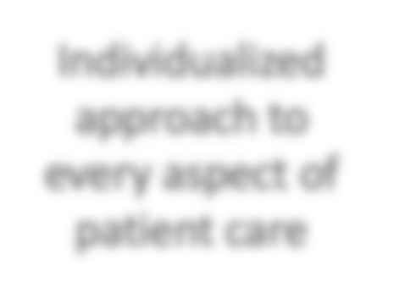

Coordinated Care Approach
Within days of enrollment:
Psychiatry
Dietitian Nursing
Wrap-around home health model that treats the whole person and family dynamic
Family Therapy Life Coaching
Case Management
Individualized approach to every aspect of patient care
Support Groups Wellness Courses
“Access to the clinical team is unparalleled.”
Individual Therapy

Slide 48






Access to Care: 10x Higher than National Averages
30
days
The average wait time to receive therapy or psychiatry in the U.S. is from 48 to 67 days.
14
days
Same- Day Access
10
days
7
days
7
days
0
Case Management
3
Psychiatry
Individual Peer Support Support Groups Therapy
Home Behavioral Health Model
Nursing
Family Therapy

Slide 49

Preventive Behavioral Health Screening
100% Covered – Annual Service
Completely Confidential
Available for all health plan members ages 12+
15-minute virtual consultation
Same-day access to comprehensive mental healthcare for members and their families

Slide 50


What Our Clients Say
About
“Access to the clinical team is unparalleled”
  Nikki, Maine
Every member of the clinical team is highly professional, highly flexible, compassionate, relatable, patient-centered, highly motivated, and truly cares about my recovery and my future.”
  Jess, Connecticut
“Aspire365 is adaptable and tailored to fit my own personal recovery needs.”
  Justin, New Hampshire
“Aspire365 is a highly flexible program for someone who works 50+ hours per week—the clinical team makes an extra effort to work around your schedule”
- RJ, New Hampshire
13

Slide 51
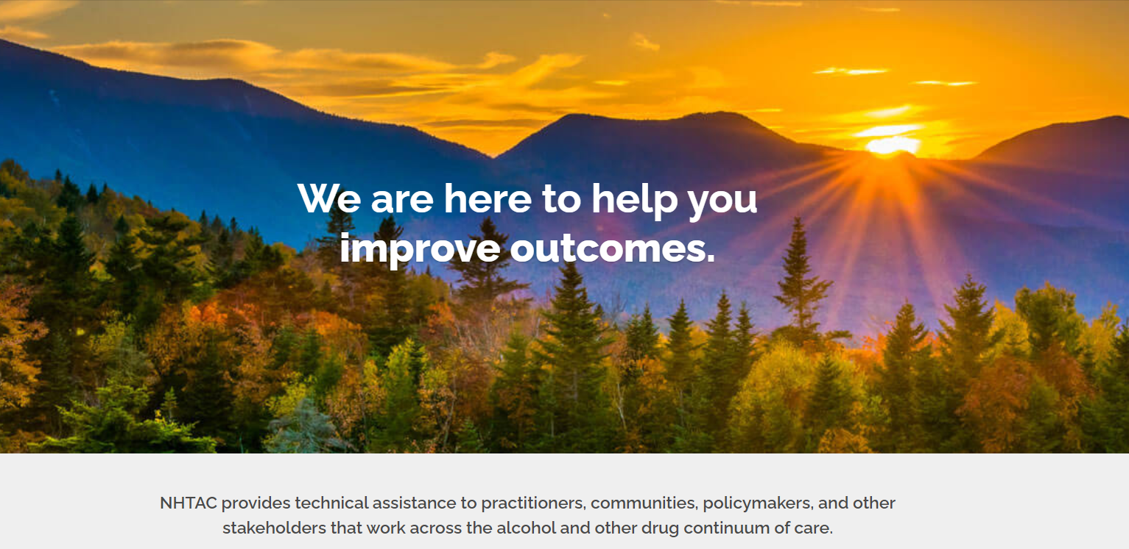
Visit us at NHTAC.org

Slide 52
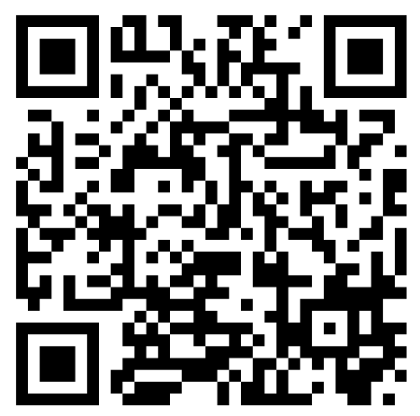
Thank You!
Your feedback is important!
Please help us continue to improve your CoP experience by completing an evaluation at this link or scanning the QR code:
https://www.surveymonkey.com/r/HSACoP081524

