Slide 1



Services for SUDs:
NH Managed Care Organizations and Behavioral Health Support
Sponsored & Facilitated by
Hospital System Addictions Care Community of Practice
Thursday, October 17th, 2024

Slide 2
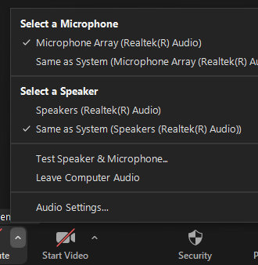
Housekeeping
Notes:
We are recording today’s meeting, so we ask that everyone mute your microphone when not speaking.
If you are having internet issues, try turning off your video camera or join by phone.
If you are having trouble hearing, expand the audio icon to open the Audio Settings – here you can select a different speaker from the menu or adjust the volume.

Slide 3
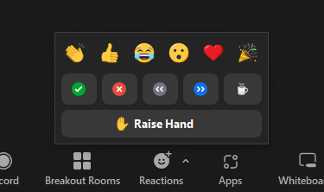
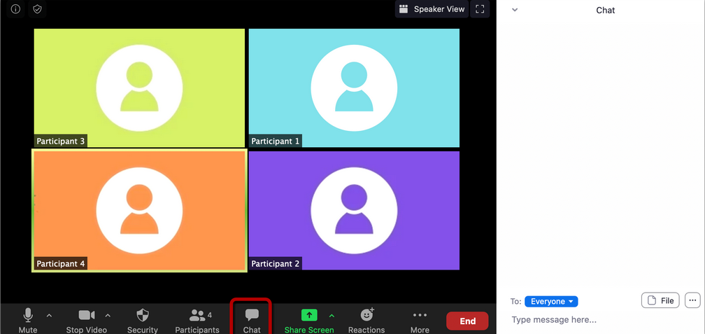
Zoom Engagement Tools
Notes:
We also encourage you to use the emoticons under your reactions tool bar to help convey emotions virtually – this could be in response to something you hear from the presenters.
Please note we will be using the chat feature for participants to post general questions to presenters. Please refrain from posting personal questions. A moderator will be posing the questions to presenters at the end of both presentations.

Slide 4

Meeting Objectives
Participants will:
  Understand the services offered by two managed care organizations.
  Learn how to access these services.

Slide 5

Donald McNally, D.O.
Medical Director of Behavioral Health Addiction Psychiatrist
NH Healthy Families
Steven Descoteaux, M.D.
Addiction Medical Director
Carelon Behavioral Health
Amerihealth

Slide 6
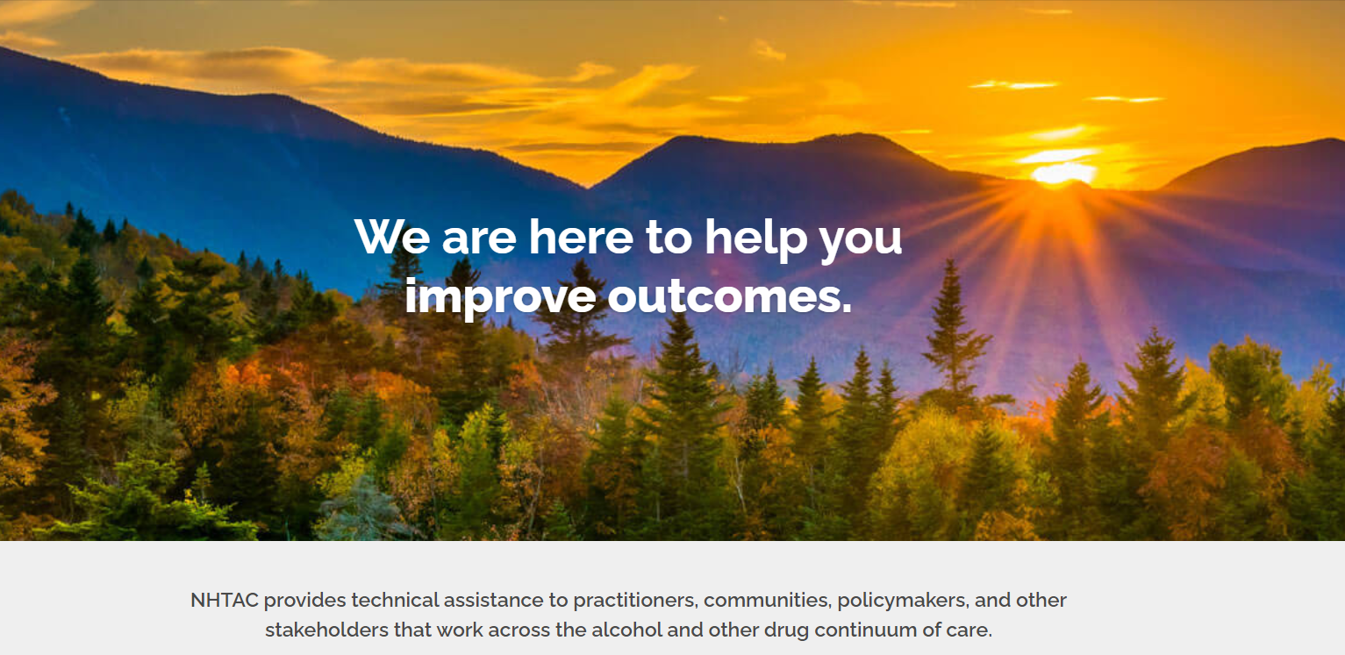
Visit us at NHTAC.org

Slide 7
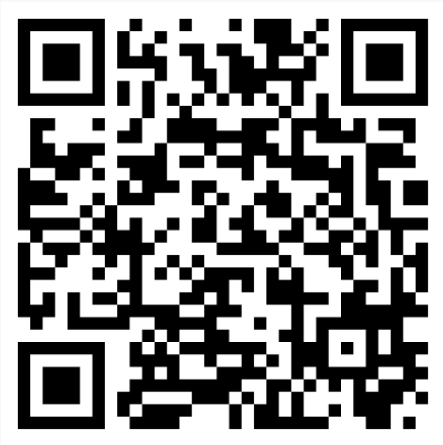
Thank You!
Your feedback is important!
Please help us continue to improve your CoP experience by completing an evaluation at this link or scanning the QR code:
https://www.surveymonkey.com/r/HSACoP101724

